Slide 1
Color characterization of virtual reality devices using professional- and consumer-grade instruments
Wei-Chung Cheng
Division of Imaging, Diagnostics, and Software Reliability
Office of Science and Engineering Laboratories
Center for Devices and Radiological Health
U.S. Food and Drug Administration
*The mention of commercial products, their sources, or their use in connection with material reported herein is not to be construed as either an actual or implied endorsement of such products by the Department of Health and Human Services. This is a contribution of the US Food and Drug Administration and is not subject to copyright.

Slide 2
Introduction
Color characterization is important when AR/VR devices are used for research
  Vision research, color science, lighting, automotive, behavior science, and cognitive science
Missing standard testing method for color characterization for AR/VR devices
  Information Display Measurements Standard (IDMS)
  International Committee for Display Metrology (ICDM) recommends many testing methods for spatial resolution; not much update on color measurement
  Costly instrumentation and professional set-up are required; not practical for end users to conduct QA/QC remotely, especially during the pandemic
Research question: “Can consumer-grade instruments be used to measure color characteristics for VR devices?”

Slide 3
Overview
Color characteristics of a VR headset
Professional-grade instrument
Measurement dataset
Consumer-grade instrument
Error analysis
Calibration method
Professional
Truth
VR
Error
Consumer
Output
Calibration

Slide 4
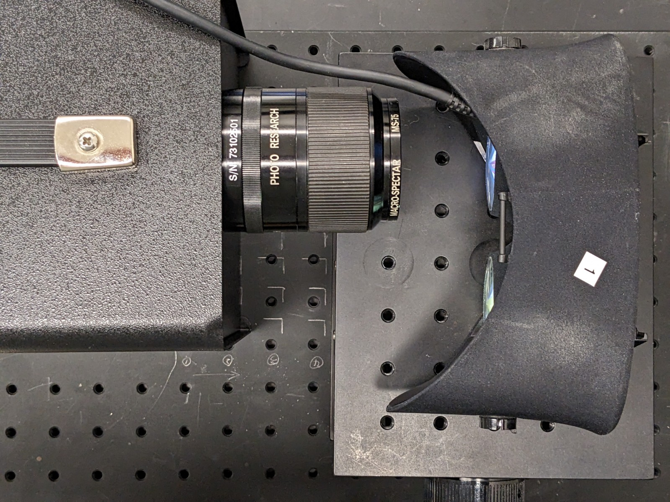
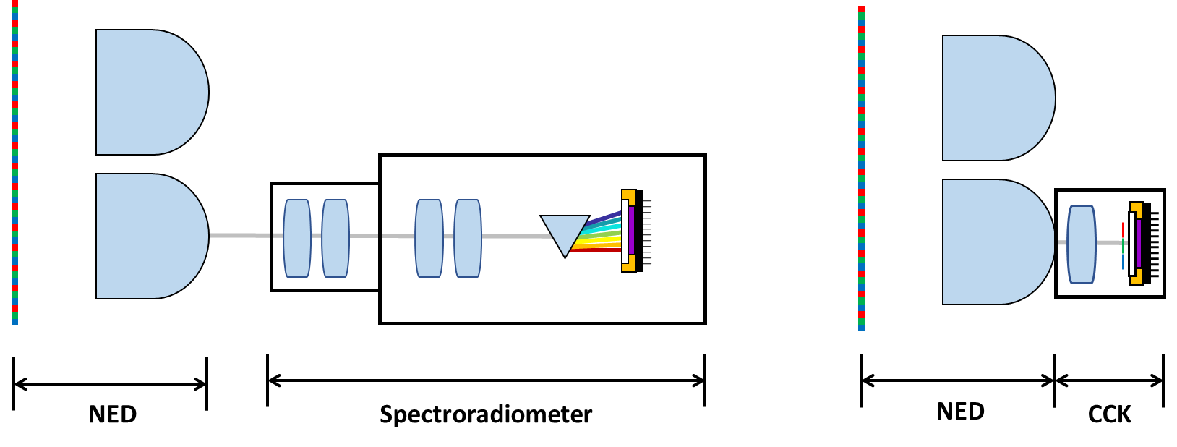
Professional-grade Instrument
Spectroradiometer (PR-730, Photo Research)
  380-780 nm @ 1 nm, 75 mm lens, 2֯ measuring aperture
  $25,000 USD
Telescopic measurement method
Newtonian viewing configuration
  No optics between headset and instrument
Criteria in Penczek, JSID, 25(4), 2017
  Light source uniformly fills the measurement field
  Angular aperture is uniformly illuminated and fills the entrance pupil

Slide 5
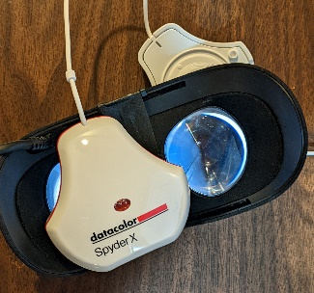
Consumer-grade Instrument
Spyder X Elite, DataColor
  Color calibration kit (CCK) intended for generating ICC color profiles for computer displays
  Colorimeter
  $250 USD (100x cheaper)
Contact measurement method
  CCK sensor was placed on ocular lens directly

Slide 6
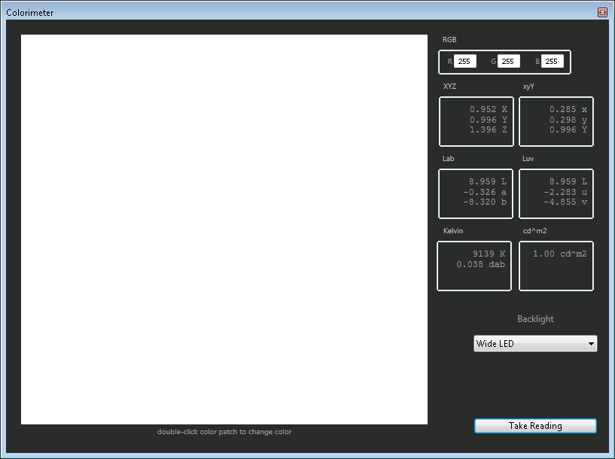
Use CCK as a Colorimeter
Spyder X Elite Software
  “Colorimeter”
  CIE xyY => CIELAB
  Backlighting options
    “Wide LED”
    “Standard LED”
    “General”
    “GB LED”
  Heuristic of LED spectrum to improve accuracy
  No documentation to explain the options

Slide 7
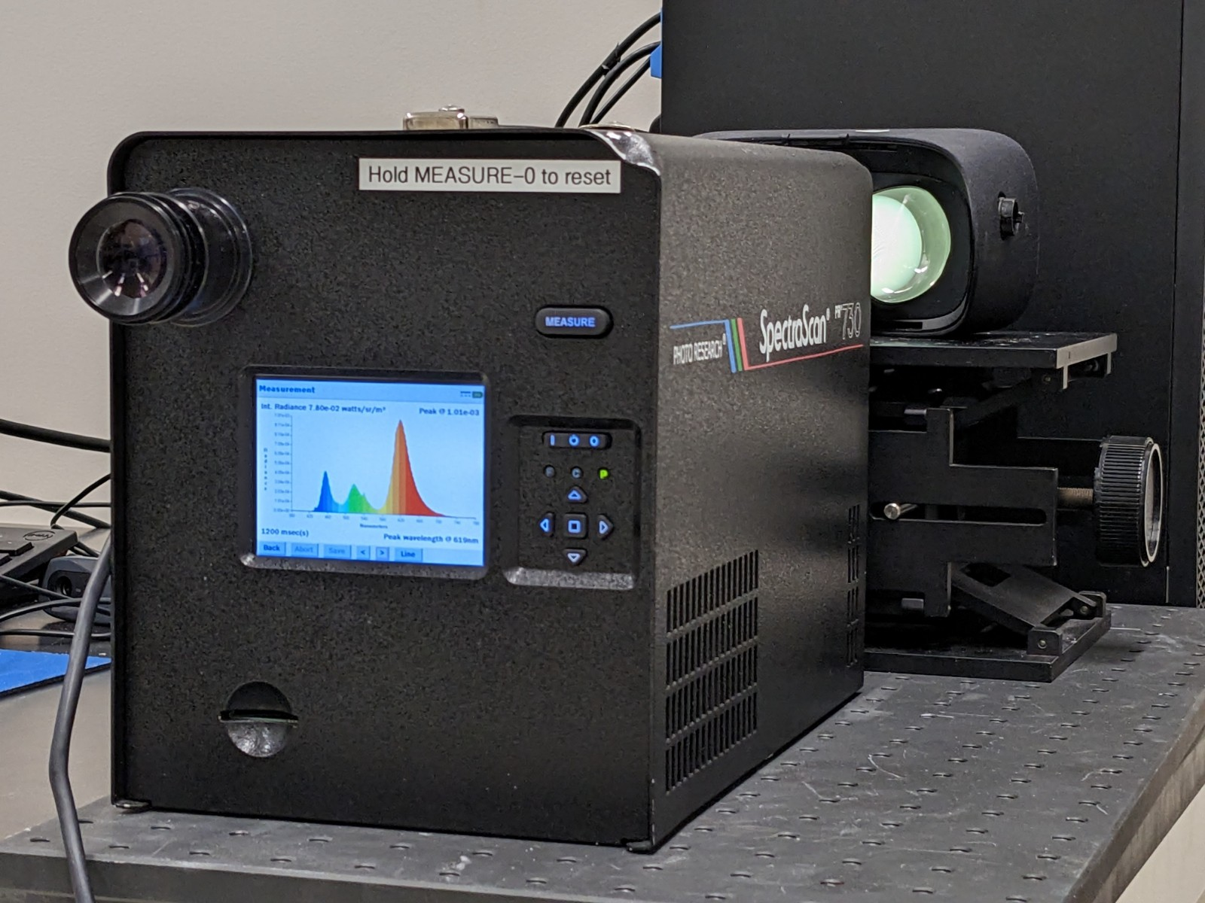
VR Headset
OLED-based VR headset (Rift, Oculus)
Driven through HDMI by Matlab on Windows 10
External display of 2160x1200 pixels
No rendering software included in the experiments
sRGB ICC color profile
Each color patch was generated as a full-screen test pattern

Slide 8
Detailed Setup
Spectroradiometer
Spectrum
CIELAB
VR
Matlab
ΔE
Win10
CCK Sensor
CIE xyY
Calibration
CIELAB
Matlab
CCK S/W
Patch

Slide 9
Datasets
 | Professional-grade | Consumer-grade
Primary colors (3 patches) | ✓
Color cube (602 patches) | ✓
ColorChecker (24 patches) | ✓ | ✓
Three test targets to generate three datasets
Datasets #1 and #2: report color gamut of Rift
Dataset #3: compare professional-grade with consumer-grade instruments

Slide 10
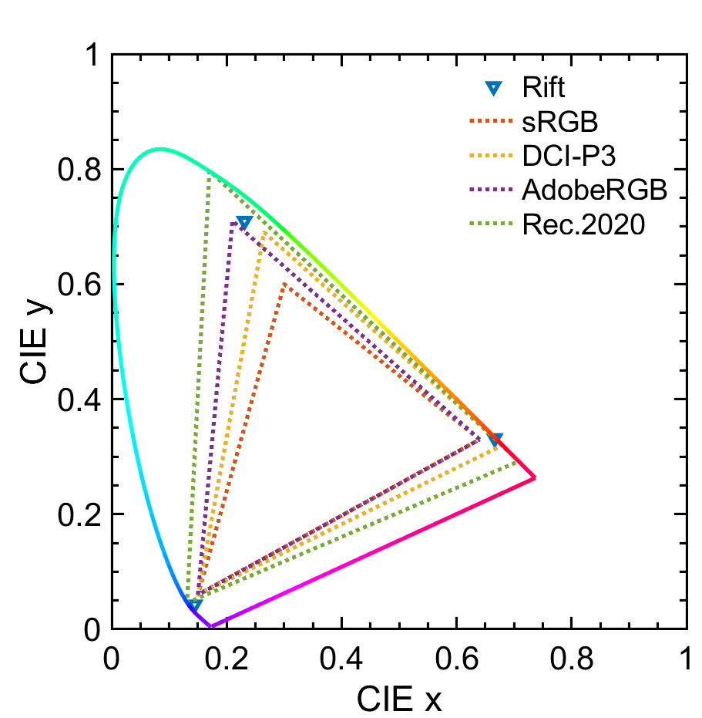
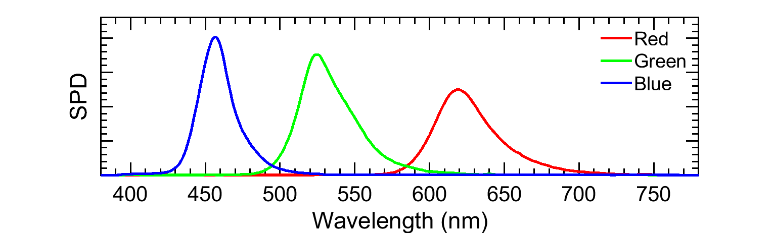
Measurement Data #1 (3 patches)
Spectra of primaries
  Narrow-band spectra generated by LEDs
  Some overlapping between R/G, G/B
Chromaticity gamut area
  IDMS 5.18
Standard color spaces
  sRGB < DCI-P3 < AdobeRGB < Rec. 2020
Doesn’t represent the darker shades

Slide 11
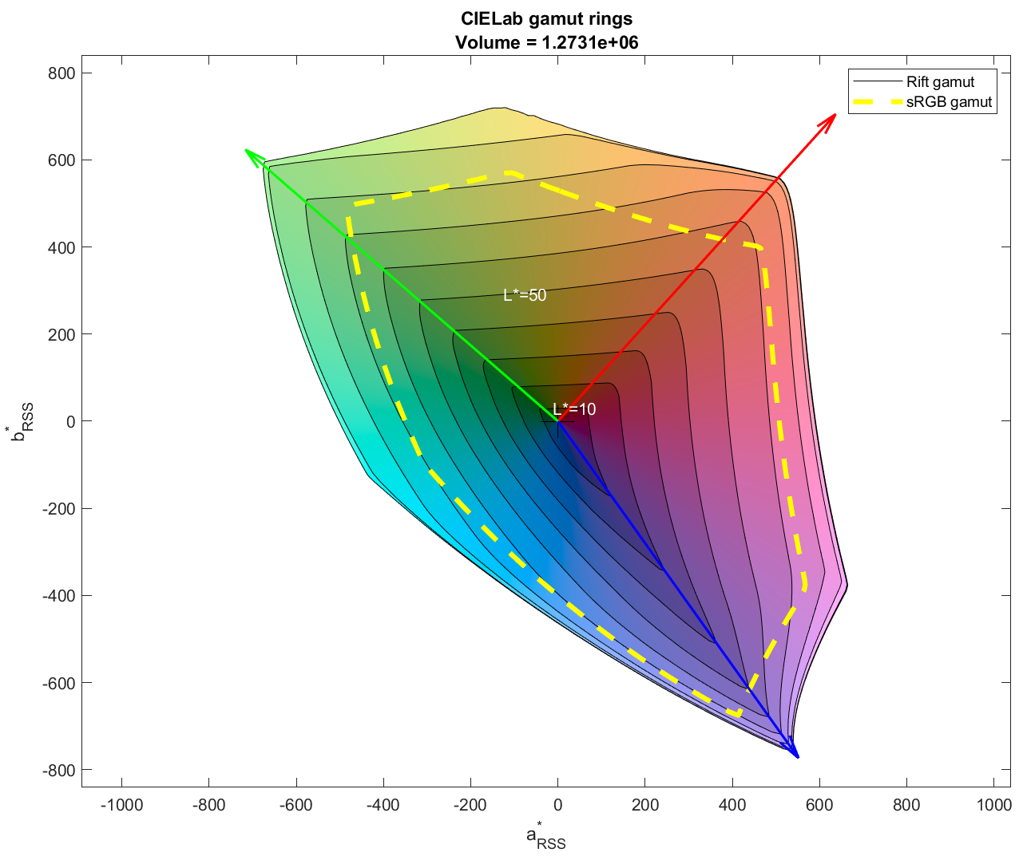
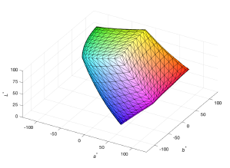
Measurement Data #2 (602 patches)
Color gamut volume
  IDMS 5.32
  6 sides per volume in CIELAB
  11x11 grid per side (121 points)
  602 points in total
Calculate volume by counting ΔE³
  Rift: 1,273,100 ΔE³
  sRGB: 830,732 ΔE³
  53.25% larger
  Calculated by IDMS Matlab code

Slide 12
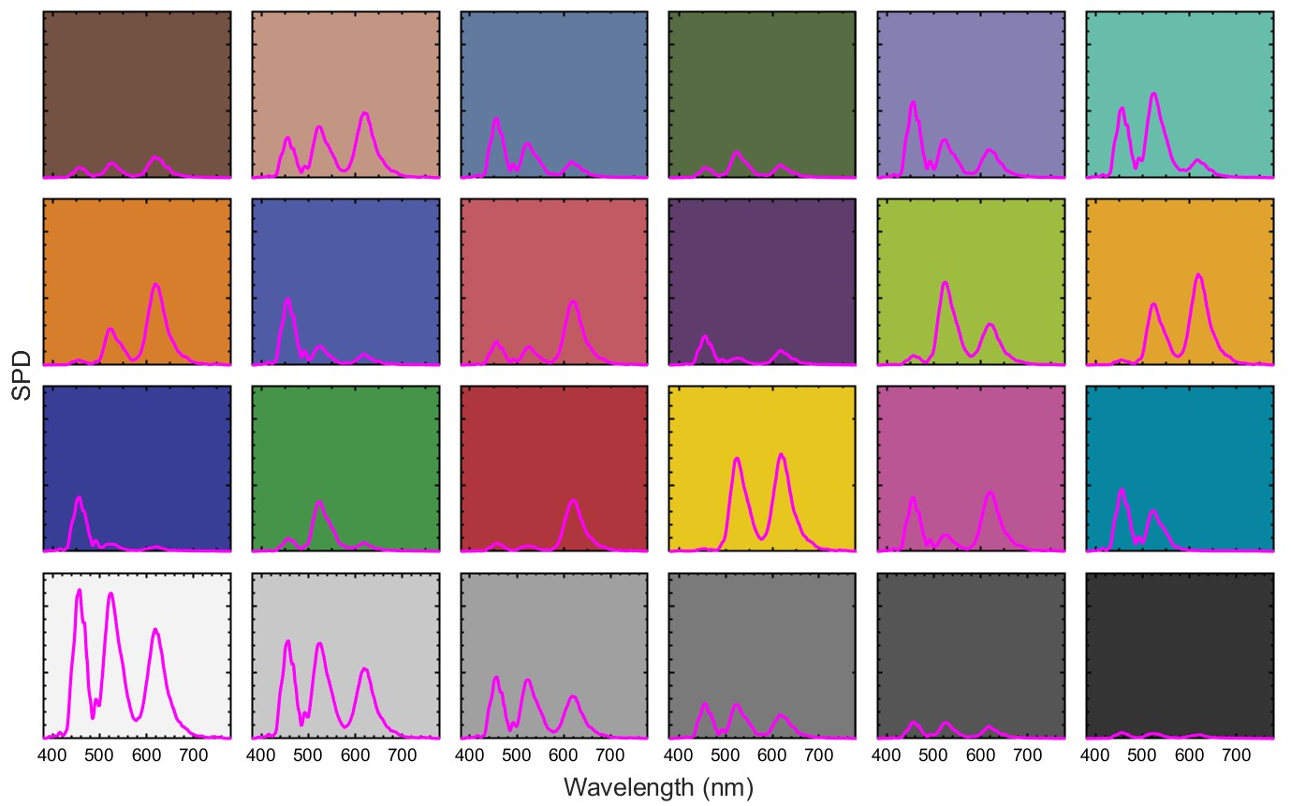
Measurement Data #3 (24 patches)
Measured spectra/shades
ColorChecker
  RGB (1 spike)
  CYM (2 spikes)
  Grayscale (3 spikes)
Ground truth

Slide 13
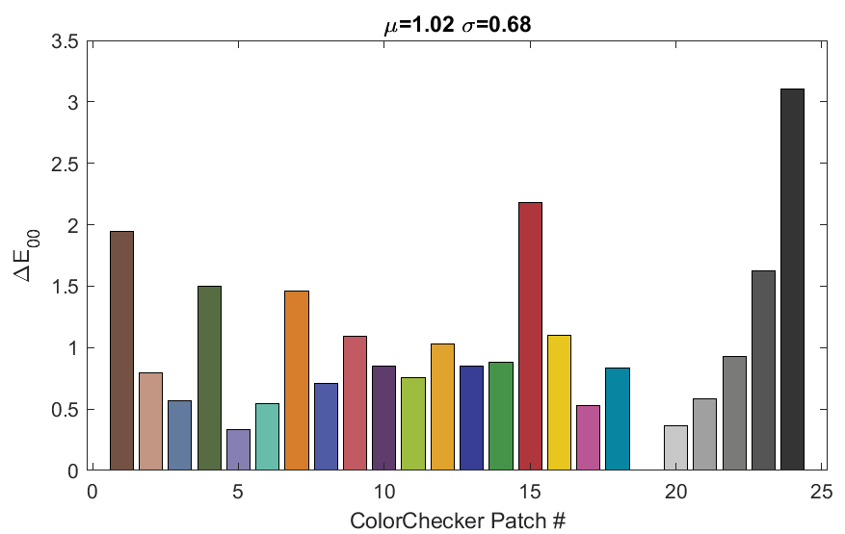
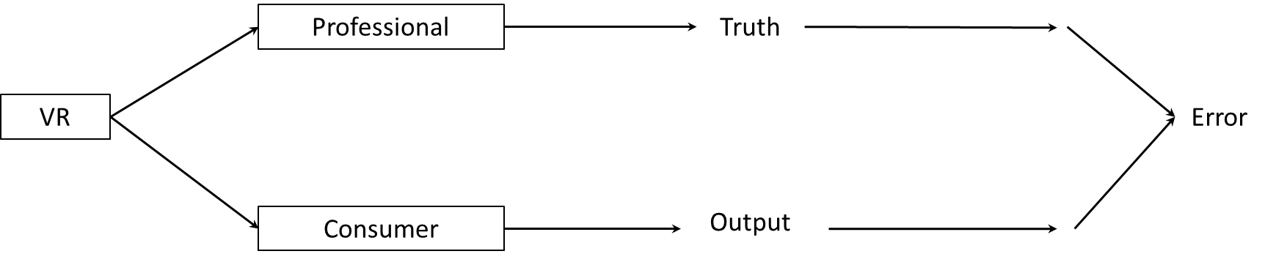
Measurement Data #3 from Consumer-grade
Color errors calculated in CIEDE2000
  “General” backlight
  Mean: 1.02 ΔE₀₀
  Maximum: 3.21 ΔE₀₀ at #24
  Standard deviation: 0.68 ΔE₀₀
Larger color errors
  Patches #1, #4, #7, #15, #23 and #24

Slide 14
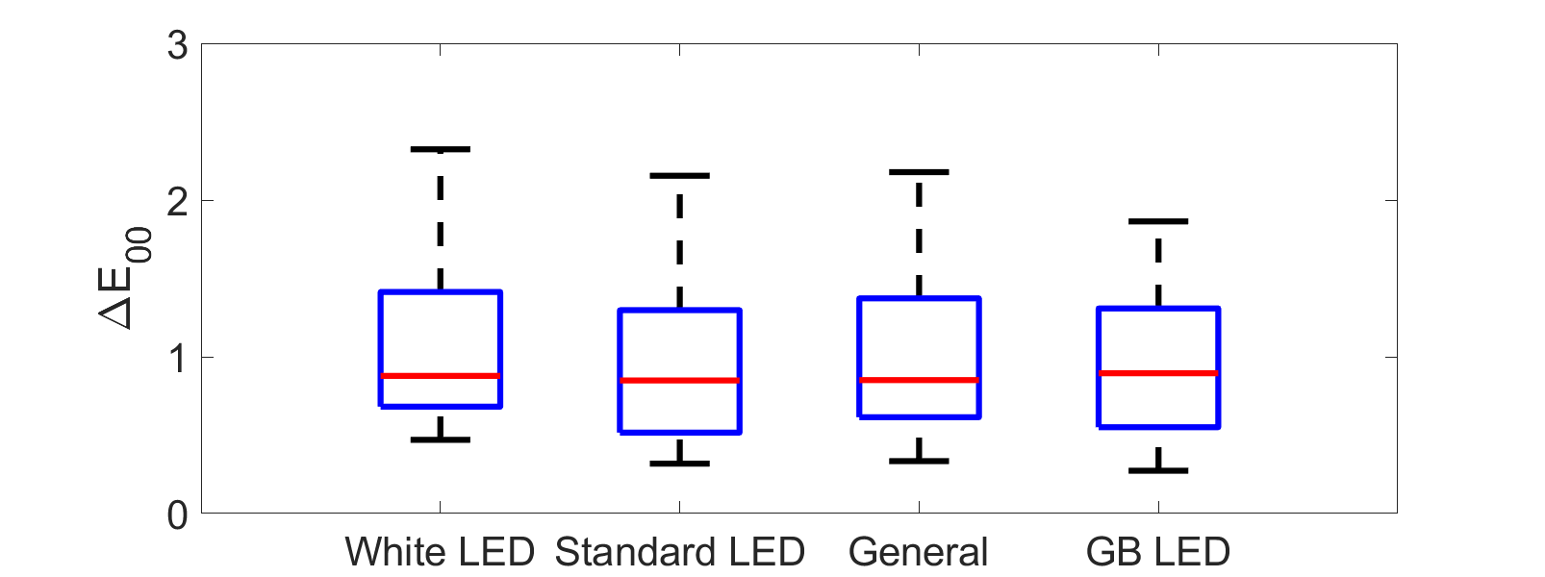
CCK Accuracy vs Backlight Mode
“Backlight modes”
  The mean errors are similar
  The backlight modes do not improve accuracy

Slide 15
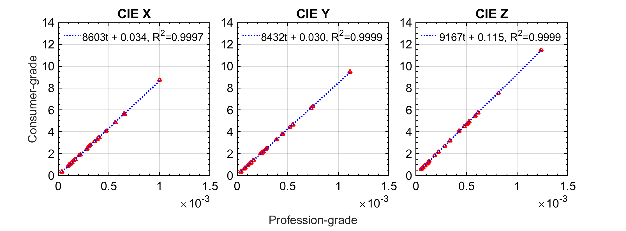
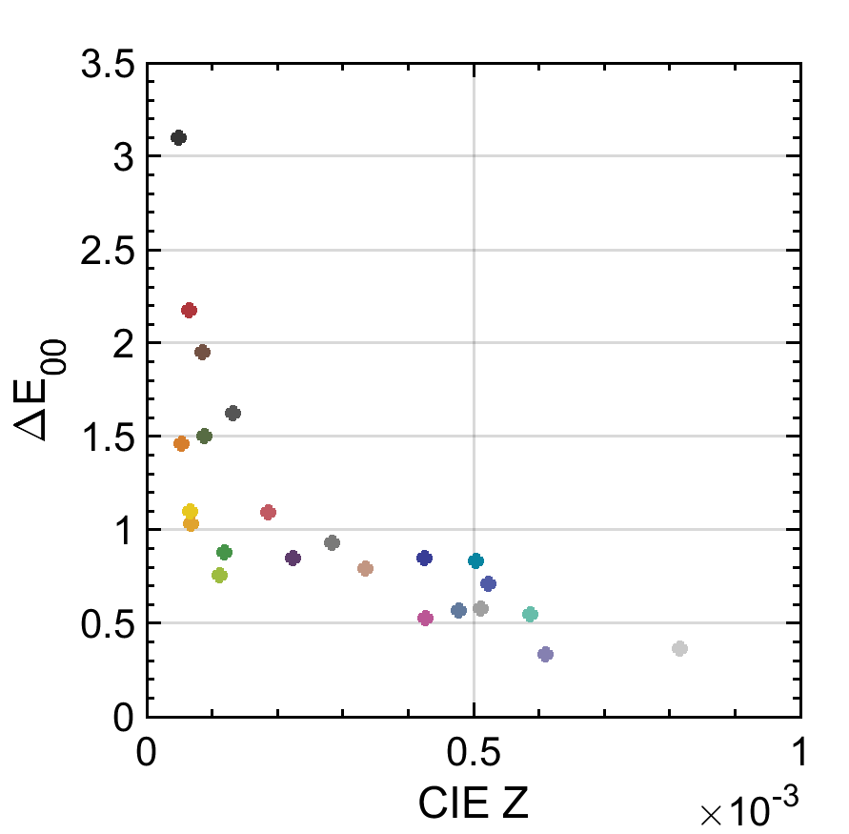
Error Analysis
Fit CIEXYZ values with linear regression
  R² > 0.99 => X, Y, and Z have perfect linearity
CIE Z deviated
  Error increases as Z decreases
  Larger errors for darker shades

Slide 16
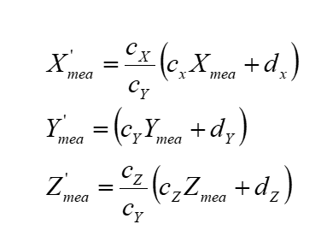
Calibration
Scale coefficients of X and Z to equalize their slopes with Y

Slide 17
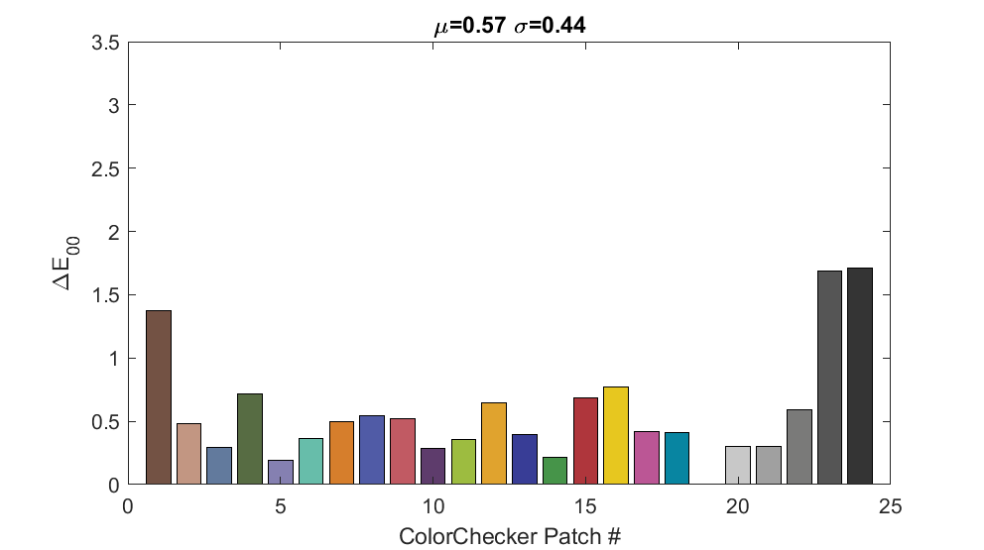
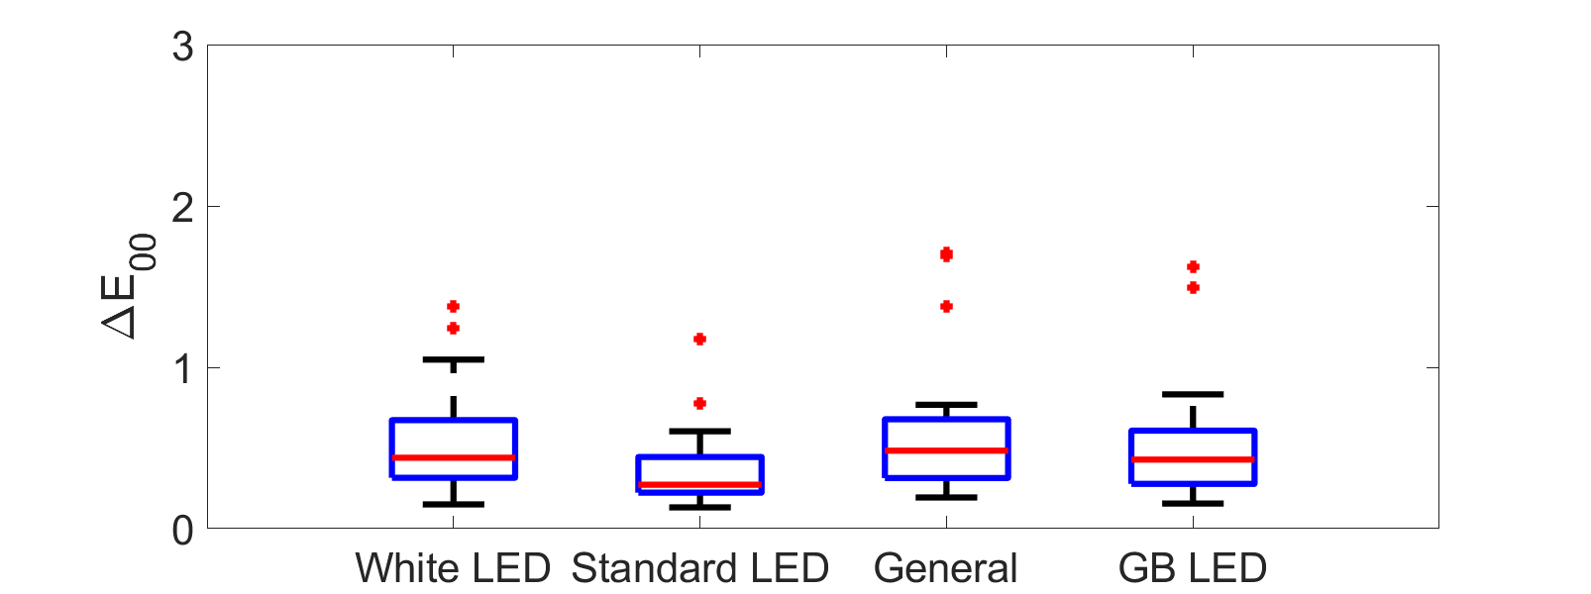
Calibration Results
Before calibration
  1.02 ΔE₀₀ (“General”)
After calibration
  0.57 ΔE₀₀ (“General”) or 44% reduction
  “Standard LED” has the lowest ΔE₀₀

Slide 18
Discussion
Rendering software is important but not included in the experiments
Consumer-grade instruments may be sufficient for measuring VR colors but not for photometric measurements such as luminance
Using a CCK as a colorimeter is a useful feature, but not all CCKs support it
CCK accuracy depends on color shades (e.g., pink shades in digital pathology)
IDMS Appendix A7 provides calibration methods for telescopic meters, but not for contact-type

Slide 19
Conclusions
Professional-grade instruments can be used by researchers to measure VR headsets in a lab setting.
Consumer-grade instruments can be used by end-users to conduct on-site quality assurance/quality control procedures.
The proposed calibration method can be used to improve accuracy of color calibration kits.
This study may help end-users make informed decisions on adopting consumer-grade instruments that are much cheaper than professional-grade instruments.

Slide 20
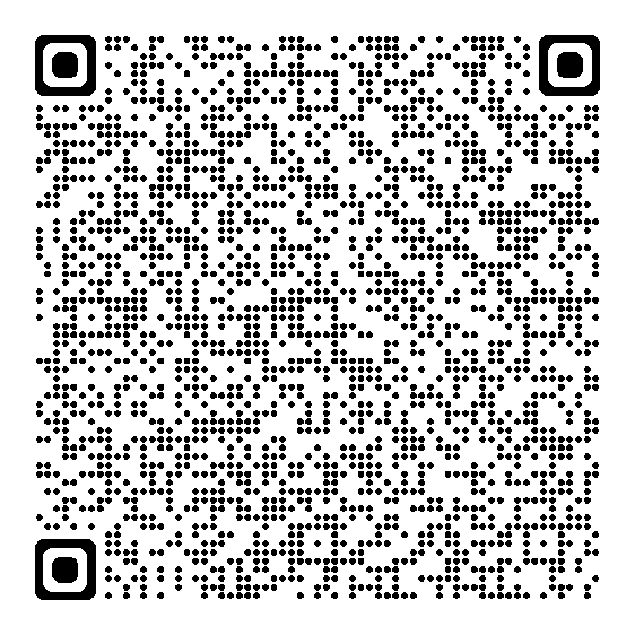
Medical Extended Reality Program
https://www.fda.gov/medical-devices/medical-device-regulatory-science-research-programs-conducted-osel/medical-extended-reality-program-research-medical-extended-reality-based-medical-devices

